Slide 1
Environmental assessment of novel processes in SULTAN project
By Raka
HIF, Freiberg

Slide 2
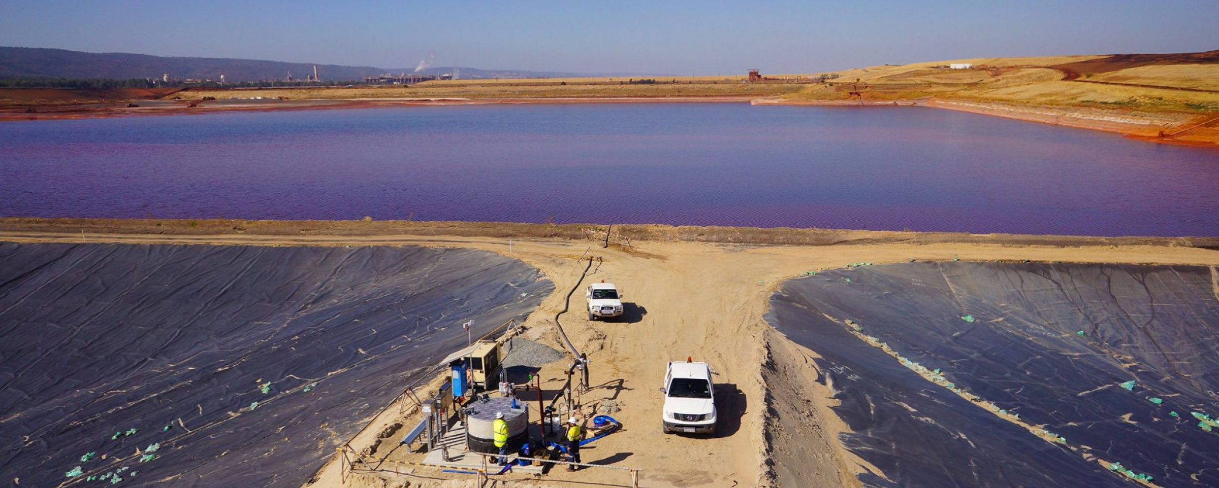
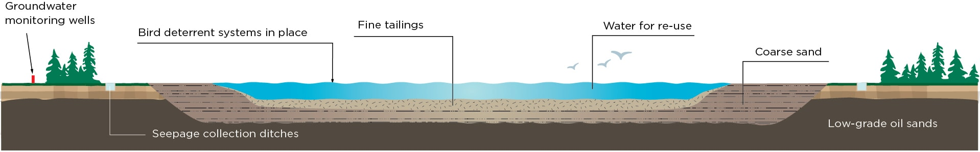
Tailings
Contain metals and matrix for reprocessing
Image: Tailings pond in Australia (Kalgoorlie mine)
Notes:
https://www.canadasoilsands.ca/en/explore-topics/tailings-ponds

Slide 3

The input material (tailings) streams: 3 case studies
41.2 Mt + 3.1 Mt/ year
11.4 Mt
1.5 Mt
Zn – Pb
Cu – Zn
Cu – Zn – Pb
Freiberg, Gemany
Plombières, Belgium
Neves Corvo, Portugal
Different characteristics
(metals and minerals content)

Slide 4






System 2: recovery and valorization route
STATUS QUO
Dispose as usual
Storage
Sulfidic Tailings
RESOURCE RECOVERY
Which products? What processes?
As secondary resources

Slide 5


How to deal with those tailings? Sultan Workflow
LCA as decision support tool
WP1
Characterization of tailings
Environmental Assessment
WP2
Recovery of valuable metals
WP4
WP3
Valorization of minerals

Slide 6
Metallurgical processes being investigated
MATERIALS RECOVERY
WP2
Life cycle inventory
Data acquisition
VALORIZATION PROCESSES
WP3
Notes:
Mention: similarities with SOCRATES

Slide 7
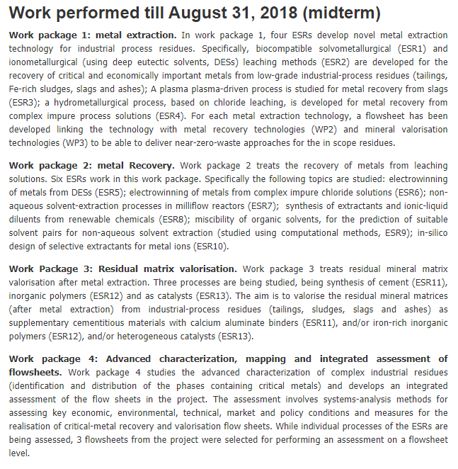
Socrates Project (WPs) – Potential collaboration & exchange
https://etn-socrates.eu/project/
Research scope
1) Metal extraction
4 processes, flowsheets linked to valorization (WP2) and metals recovery (WP3)
2) Metal recovery
6 different processes
3) Residual matrix
4) Integrated assessment
3 products (cement, Inogranic polymers, catalysts)
Which routes are selected? At what scale?

Slide 8
Assessing at different maturity stages
Stage 2
Stage 1 LCA results
Stage 1
Novel production processes from sulfidic tailings
Stage 1 vs. Stage 2
Lab scale
Scale up system model
Novel scale up vs. current production
Comparison with the other industrial scale system
Stage 3
Qualitative/ Semi quantitative | Quantitative
Screening matrix (Hung, 2018) | Upscaling (Caduff, 2013; Piccinno, 2016) Process design, simulation (Parvatker, 2019)

Slide 9
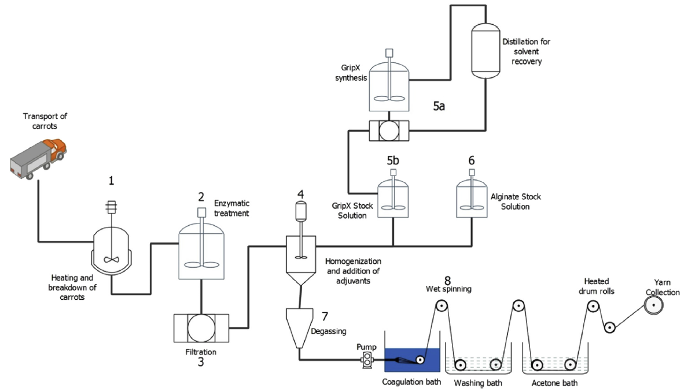
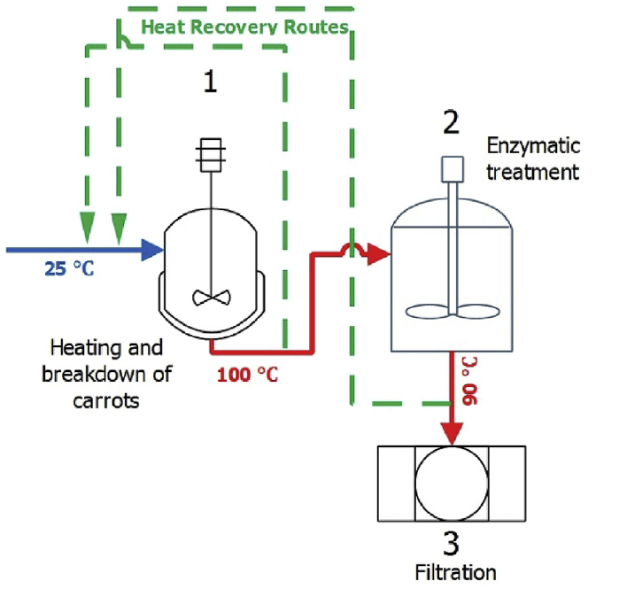
Proposed upscaling framework: engineering-based
Piccinno, 2016; Villares, 2016
Experimental results
Design plant flow diagram
Scale-up of each process
Processes linkage
Calculation of main input and outputs:
Chemical engineering
Process simulation (e.g. HSC Sim)
Expert inputs

Slide 10

Example of outcomes
Disposal
Environmental impacts
Use
Production 2
Production 1
Commercial
Pilot
Lab

Slide 11
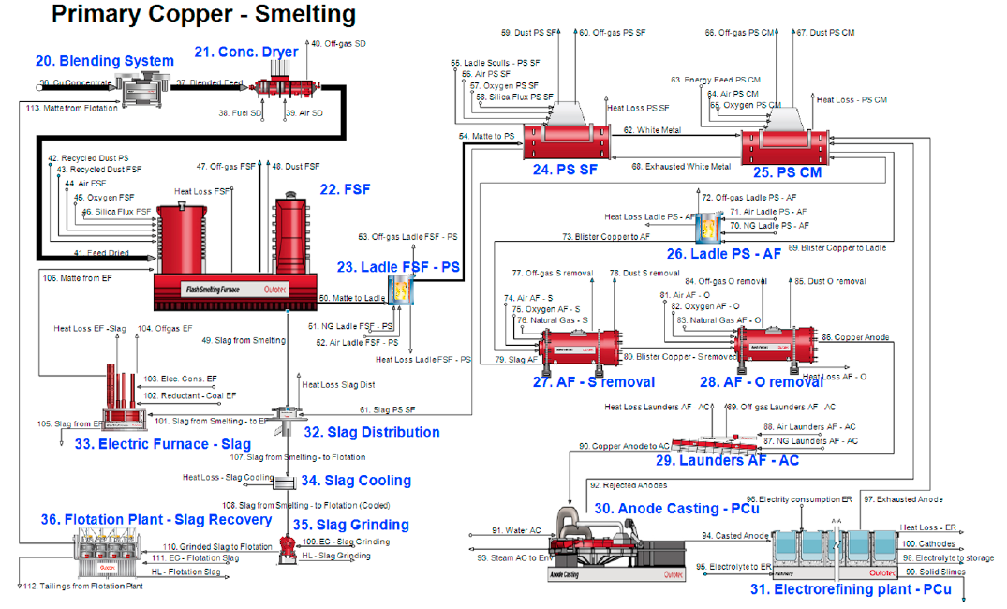
Proposed strategy
Some ideas from your papers
Identify key inventory from lab scale processes in SULTAN
Find relevant upscaling framework and parameters for specific unit process
Draw the upscaled version on process simulator (ex: HSC SIM)
Map processes’ inventory to any LCA database (via export)
Ref: Abadias Llamas, Reuter (2019)

Slide 12
What we need now and after
Exploring links between Socrates and Sultan concerning metallurgical processes – develop together the integrated assessment (especially the process flow sheeting)
How do we select specific processes which would be upscaled in Socrates?

Slide 13
Questions to answer
Upscaling project? Any experiences?
Socrates deals with the existing system in the last paper. How about the novel ones?
Can I use HSC Sim after expiration date? Any suggestions?
Can I meet again next week or submit something to show my ideas before leaving?
I plan to return next year for 1 month (showing progresses and collaborate with Alejandro)
Your plan visiting ETH Zurich in January 2020: we are looking forward to it!

Slide 14
Thank you
Raka, research assistant @ESD & SULTAN

